Slide 1
Project Name :Diabetes Prediction
Name- Vikram Pratap Singh
Master in Data Science- Guvi
Email – sify.vikram@gmail.com

Slide 2
Problem Understanding
Diabetes is a chronic disease that occurs when the body is unable to regulate blood sugar levels effectively.
This can lead to serious health complications, including heart disease, kidney failure, and nerve damage.
Early diagnosis and management are crucial to prevent these complications.
However, diagnosing diabetes can be challenging and resource-intensive.
Traditional methods involve various medical tests and patient history analysis, which may not always be accessible or affordable for everyone.

Slide 3
Solution
Data Collection and Preprocessing: Gather and clean the dataset containing relevant features such as age, BMI, blood pressure, glucose levels, insulin levels, and other health indicators.
Exploratory Data Analysis (EDA): Understand the data distribution, identify correlations, and visualize relationships between features.
Model Development: Implement and compare different machine learning algorithms (e.g., logistic regression, decision trees, random forests, SVM, neural networks) to find the best-performing model.
Model Evaluation: Evaluate the models using appropriate metrics such as accuracy, precision, recall, F1-score, and AUC-ROC curve to ensure robustness and reliability.
Model Deployment: Develop an easy-to-use interface or application for healthcare professionals and patients to input data and receive predictions.

Slide 4
Goal of the project
Primary Goal: Predict the outcomes of horse races, focusing on win or place results.
Secondary Goals: Identify significant race outcome features, address dataset imbalance, and build a robust prediction model.
Data Preprocessing: Clean data by handling missing values, normalizing where applicable, and converting categorical variables to numerical formats. Engineer features by creating new metrics and aggregating across races, integrating datasets as needed.
Exploratory Data Analysis (EDA): Conduct descriptive statistics and correlation analyses, visualize data distributions and feature relationships using plots and heatmaps.
Model Development: Evaluate various machine learning models through cross-validation, employ techniques like SMOTE for imbalanced data, apply feature selection methods such as RFE and regularization, and optimize hyperparameters using grid and random search.

Slide 5
Benefits from the Project
Early Detection: By predicting diabetes early, individuals can take preventive measures to manage their health better and reduce the risk of complications.
Cost-Effective: Automated predictions can reduce the need for extensive medical tests and frequent doctor visits, making healthcare more affordable and accessible.
Improved Healthcare: Healthcare providers can use the model to identify high-risk patients quickly and prioritize their care, leading to more efficient and effective treatment.
Personalized Treatment Plans: Insights from the model can help in tailoring personalized treatment and lifestyle modification plans for patients based on their risk factors.
Awareness and Education: The project can raise awareness about diabetes and its risk factors, encouraging people to monitor their health and adopt healthier lifestyles.

Slide 6
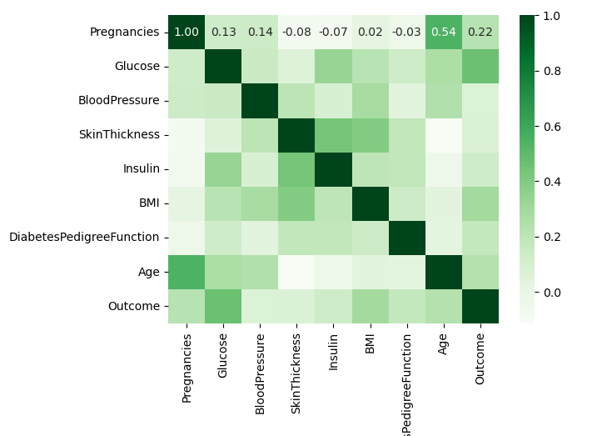
EDA

